Slide 1
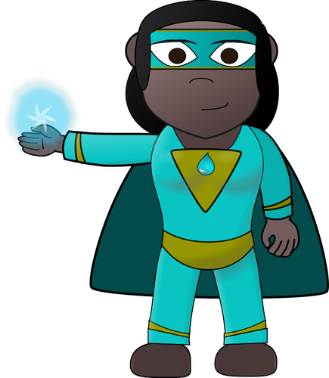
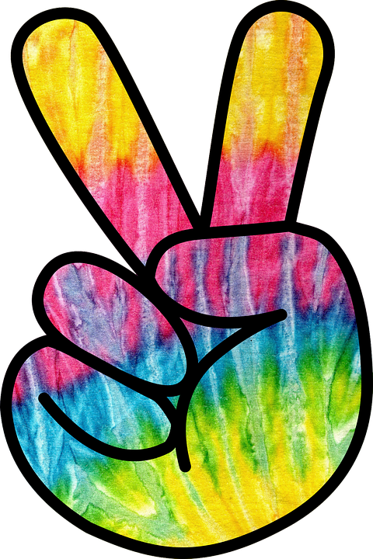
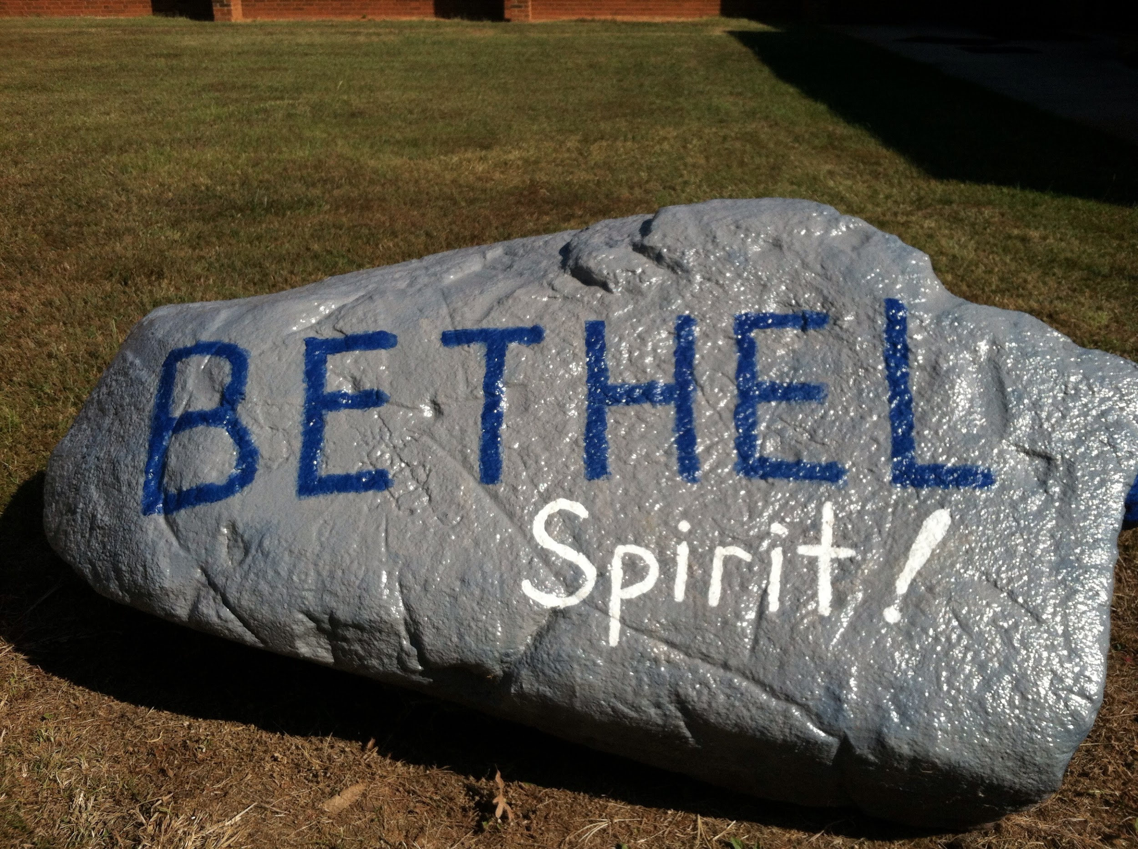
The Great Kindness Challenge Spirit Week
February 14 - 18th 2022
Monday | Tuesday | Wednesday | Thursday | Friday
POWERED BY KINDNESS (Superhero Day) | PEACE, LOVE, and KINDNESS (Tie Dye/70’s wear) | Wacky for KINDNESS (Dress Wacky) | DREAMING of KINDNESS (Pajama Day) | Community Kindness (Wear blue/white or Bethel attire)

